Slide 1
Machine Learning
DSECL ZG565
Practice Problems
Dr. Monali Mavani
These slides are prepared by the instructor, with grateful acknowledgement of Prof. Tom Mitchell, Prof.. Burges, Prof. Andrew Moore and many others who made their course materials freely available online

Slide 2

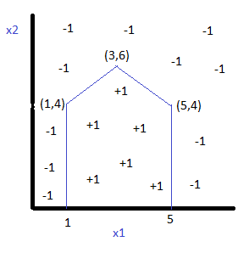
Question
The decision boundary for a two-class +1/-1 problem is given below in left. Specify the parameters weights and bias of the perception network on the right that can generate the given decision boundary. Note for a perceptron node, the output is +1 for input greater than or equal to 0, else output is -1.
BITS Pilani, Deemed to be University under Section 3 of UGC Act, 1956

Slide 3
Question
Solve the below and find the equation for hyper plane using linear Support Vector Machine method. Positive Points: {(3, 2), (4, 3), (2, 3), (3, -1)} Negative Points: {(1, 0), (1, -1), (0, 2), (-1, 2)}
BITS Pilani, Deemed to be University under Section 3 of UGC Act, 1956

Slide 4
Question
Use kernel trick and find the equation for hyper plane using nonlinear SVM. Positive Points: {(2,0), (3,0), (4,0)} Negative Points: {(0,0), (1,0), (5,0), (6,0)}
BITS Pilani, Deemed to be University under Section 3 of UGC Act, 1956

Slide 5
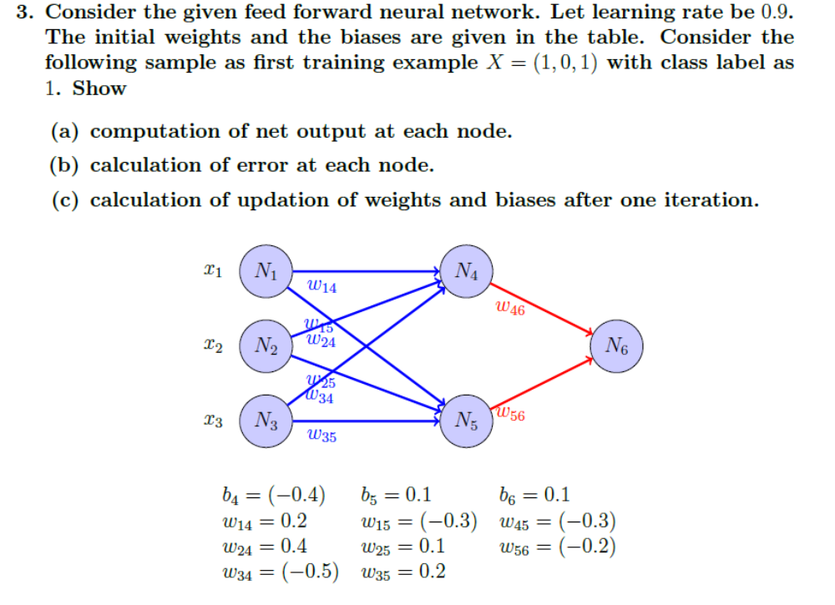

Slide 6
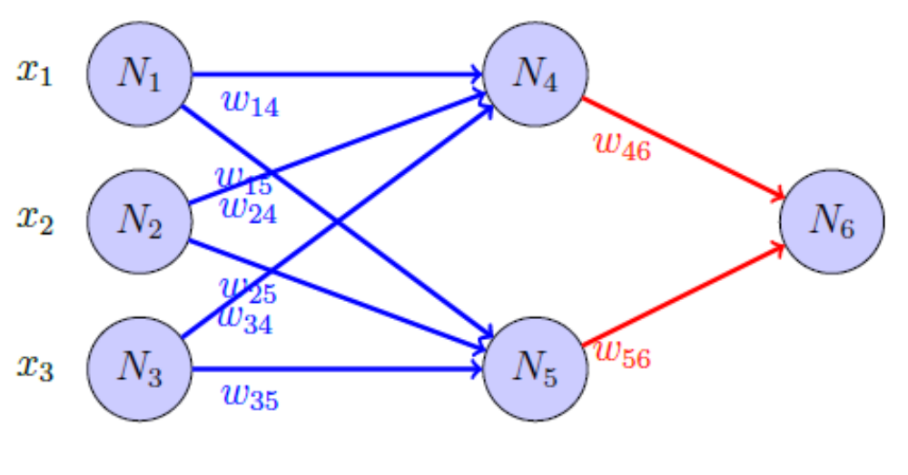
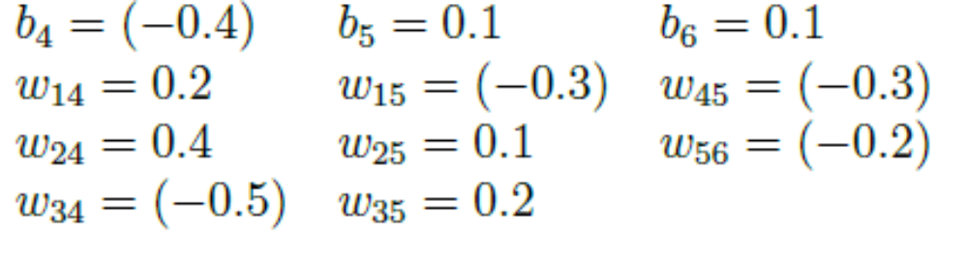

Slide 7
Thank you
BITS Pilani, Deemed to be University under Section 3 of UGC Act, 1956

